Slide 1

CONTENTS
Features (2 min)
Live Demo (2 min)
Application Logic (3 min)
Algorithm
Code
Development/Build Process (3 min)
Challenges
Ethical issues
Favourite parts

Slide 2

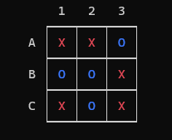
Unbeatable TicTacToe AI
Punit Dharmadhikari T1A3 Terminal Application

Slide 3

Features
Single and Multiplayer Mode
Simulation Mode
Helpful Instructions
Saving Games to File
Loading Previous Games from File
Unbeatable TicTacToe AI

Slide 4
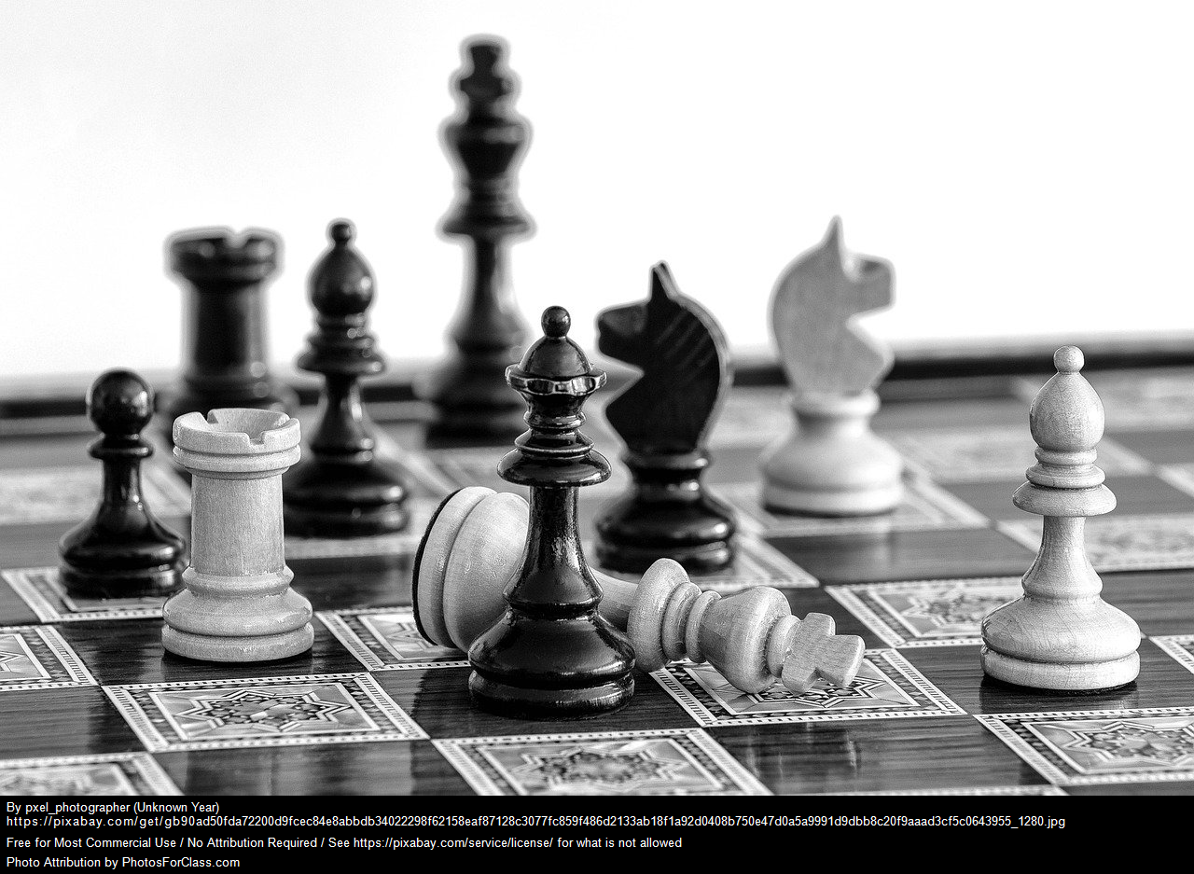
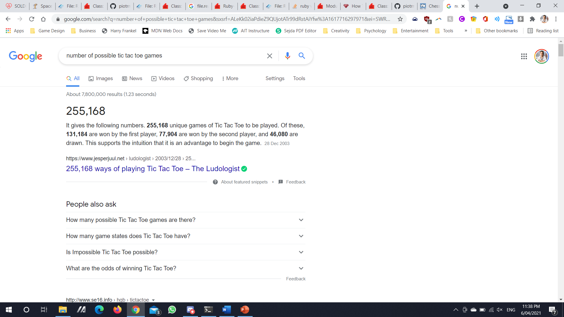
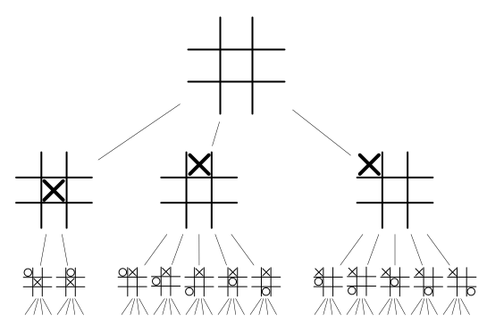
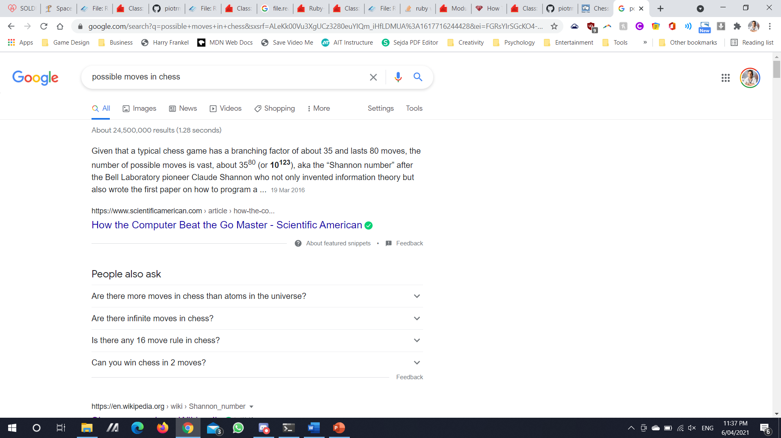
Game Tree Complexity

Slide 5
Live Demo

Slide 6
Code
<CODE> </CODE>
Coding process

Slide 7

Ruby Gems
TTY-PROMPT
To create selectable option menus
COLORIZE
To add colour and life to the project
TTY-TABLE
To create neat-looking tables that display save game information
UUID
To create unique IDs for save games
TTY-BOX
To create messages in a box

Slide 8
Control Flow

Slide 9
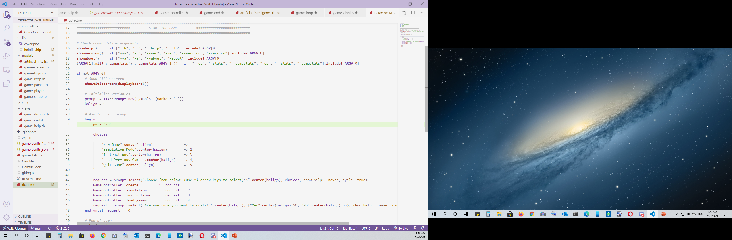

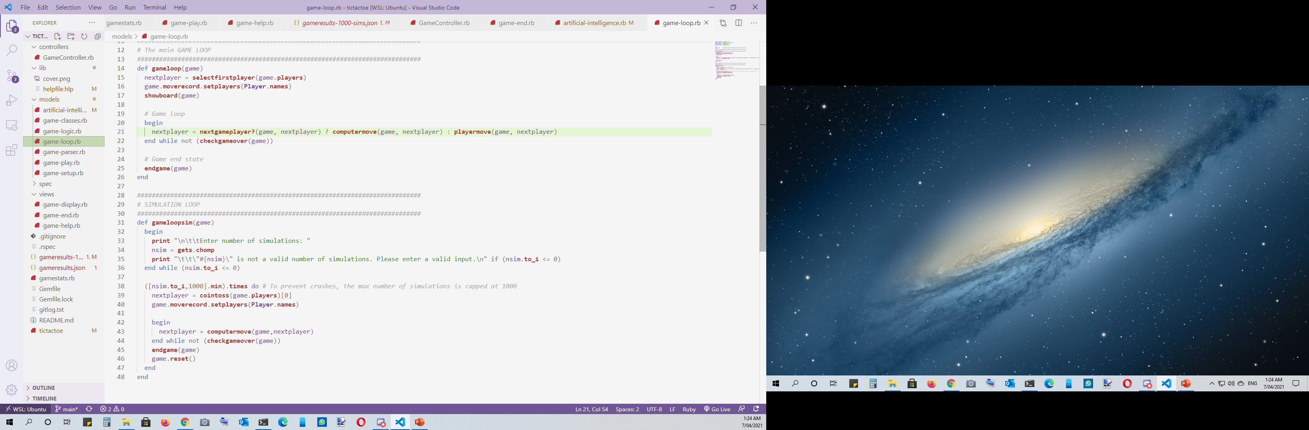

Slide 10
Classes

Slide 11





Slide 12
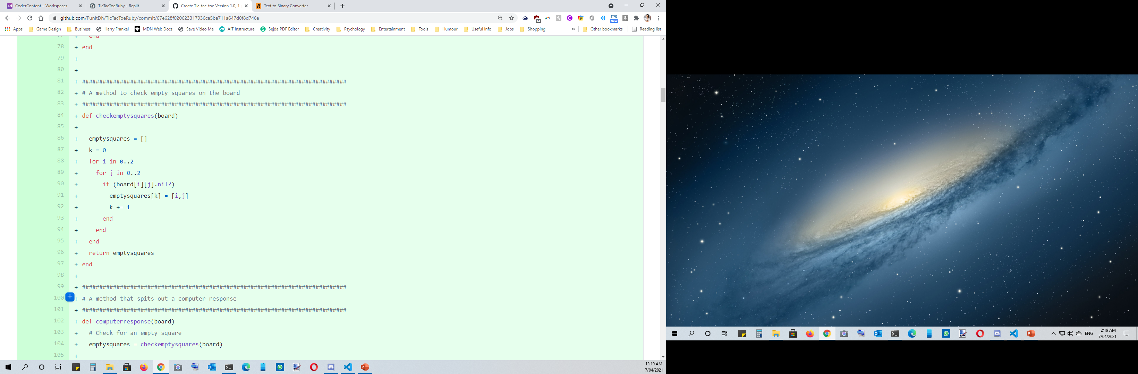
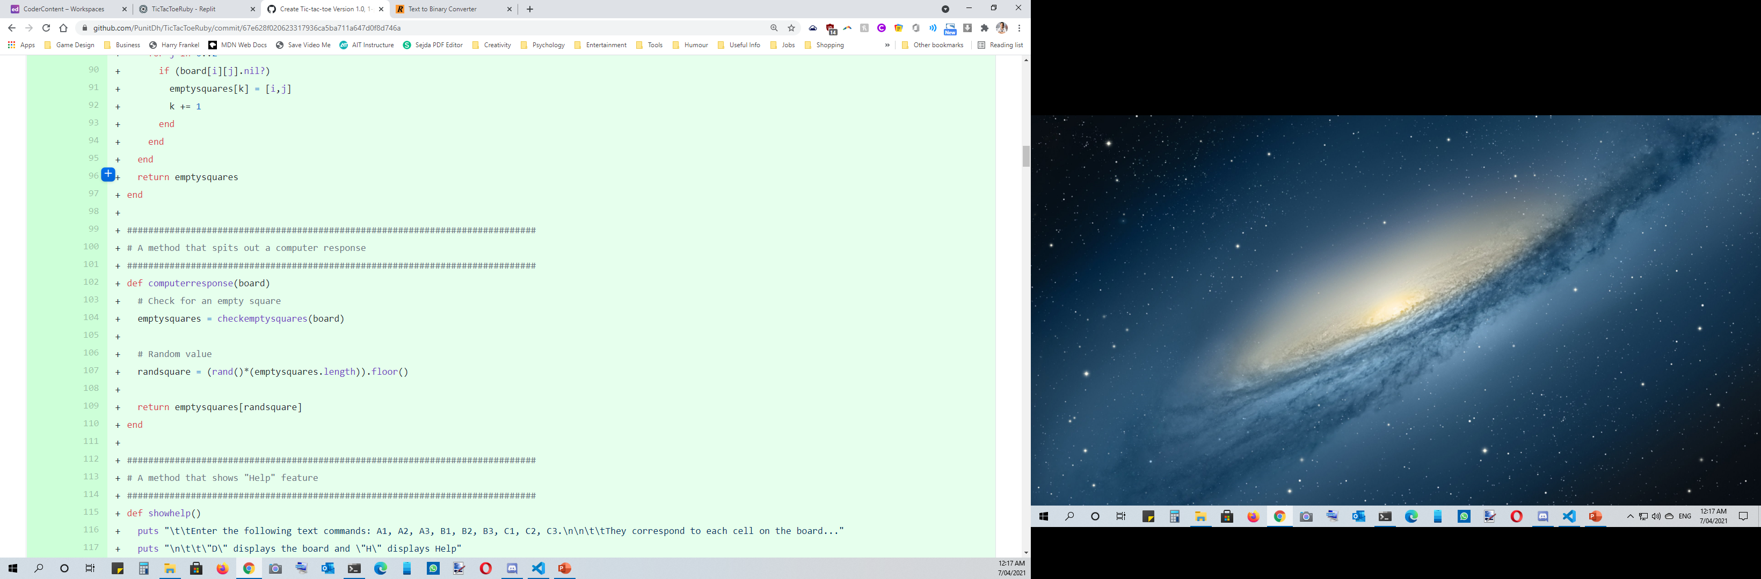
Computer move…

Slide 13
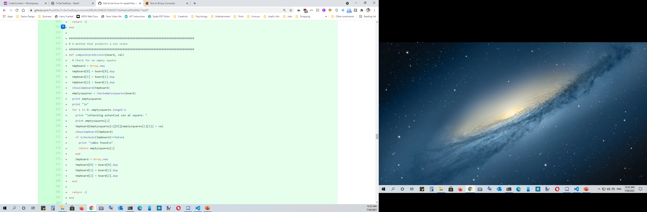
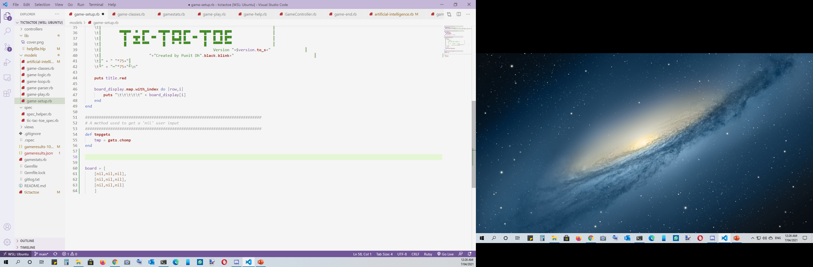









Computer move…
Notes:
It’s still not good enough… I want the computer to be able to beat the player

Slide 14
Taking it a step further…
To Algorithms and Beyond…

Slide 15
Minimax Algorithm
010000010110110001100111011011110111001001101001011101000110100001101101…
Behaviour Trees

Slide 16
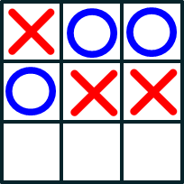

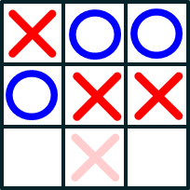
Minimax Algorithm
X’s turn to play

Slide 17
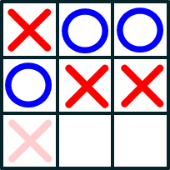
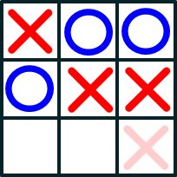
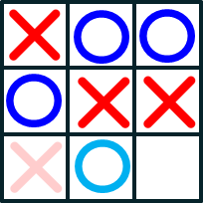
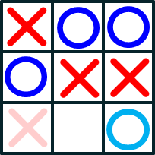
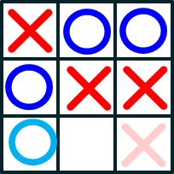
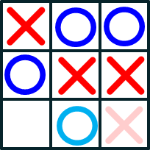
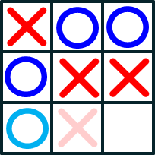
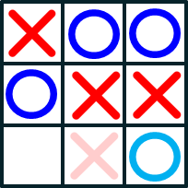
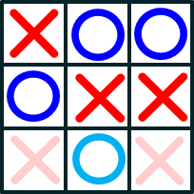
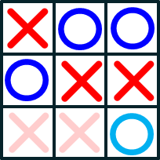
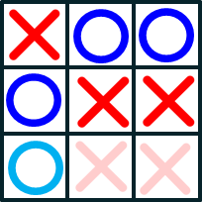
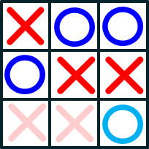
Minimax Algorithm
Score: 1
Score: 1
Score: 1
Is it a win?
Is it a draw?
X’s turn to play
Is it a win?
Is it a draw?
O’s turn to play
Is it a win?
Is it a draw?
X’s turn to play
Score: 1
Score: 0
Score: 1
Score: 0

Slide 18
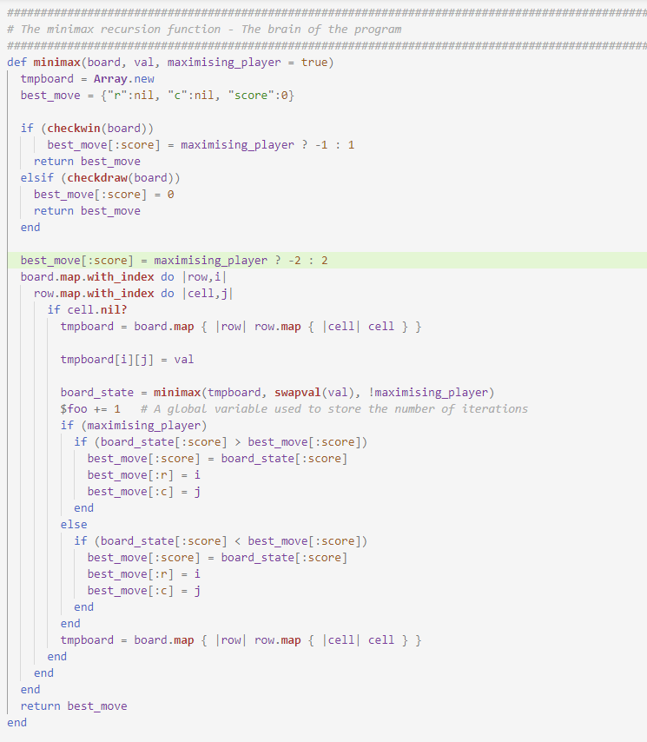
Minimax Algorithm
Notes:
So what does this look like in code?

Slide 19
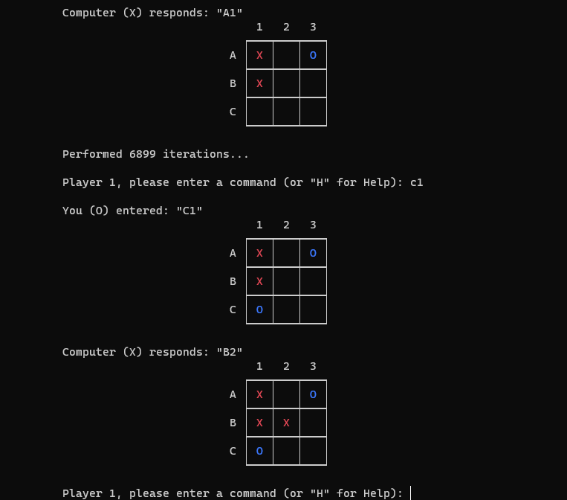
DOES IT WORK???
Notes:
Here is one of my most famous losses

Slide 20
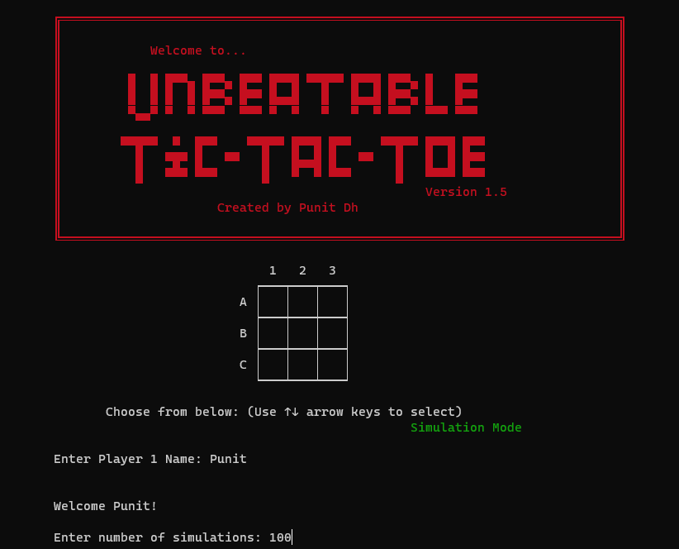
Simulation Mode (AKA had I actually created an unbeatable AI?)

Slide 21
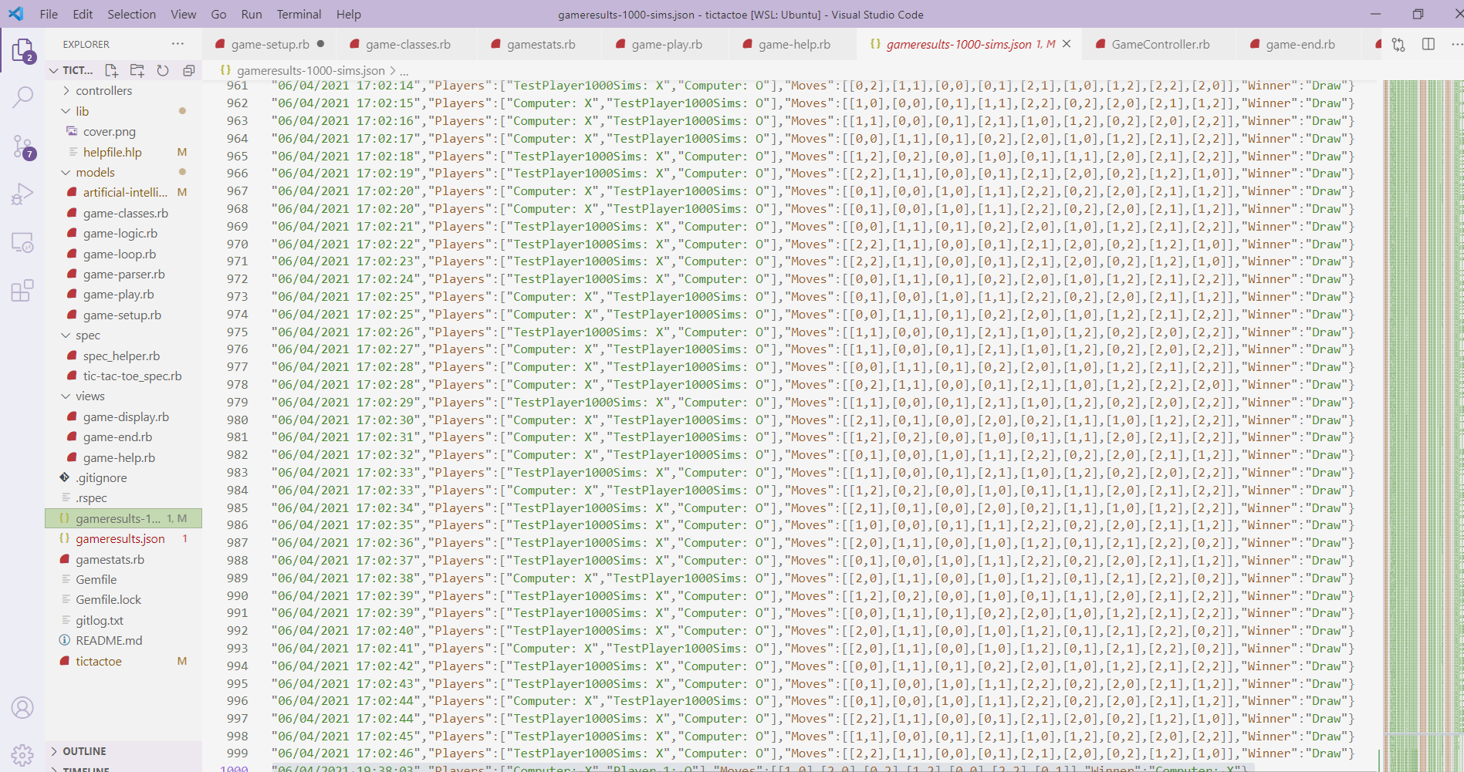
Results

Slide 22

Development and Build Process

Slide 23
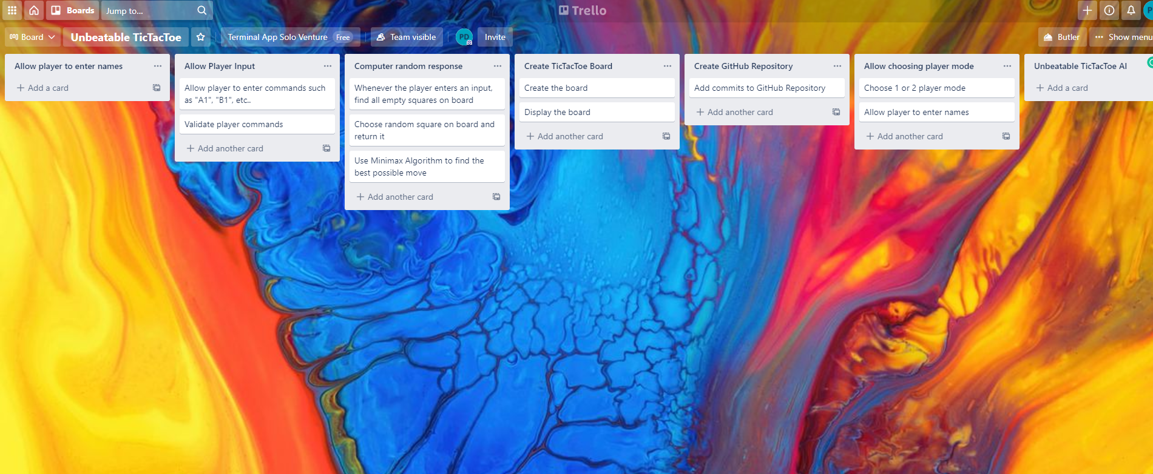
Project Management Platform
https://trello.com/b/HZZdvodu/unbeatable-tictactoe

Slide 24

Design Decisions

Slide 25


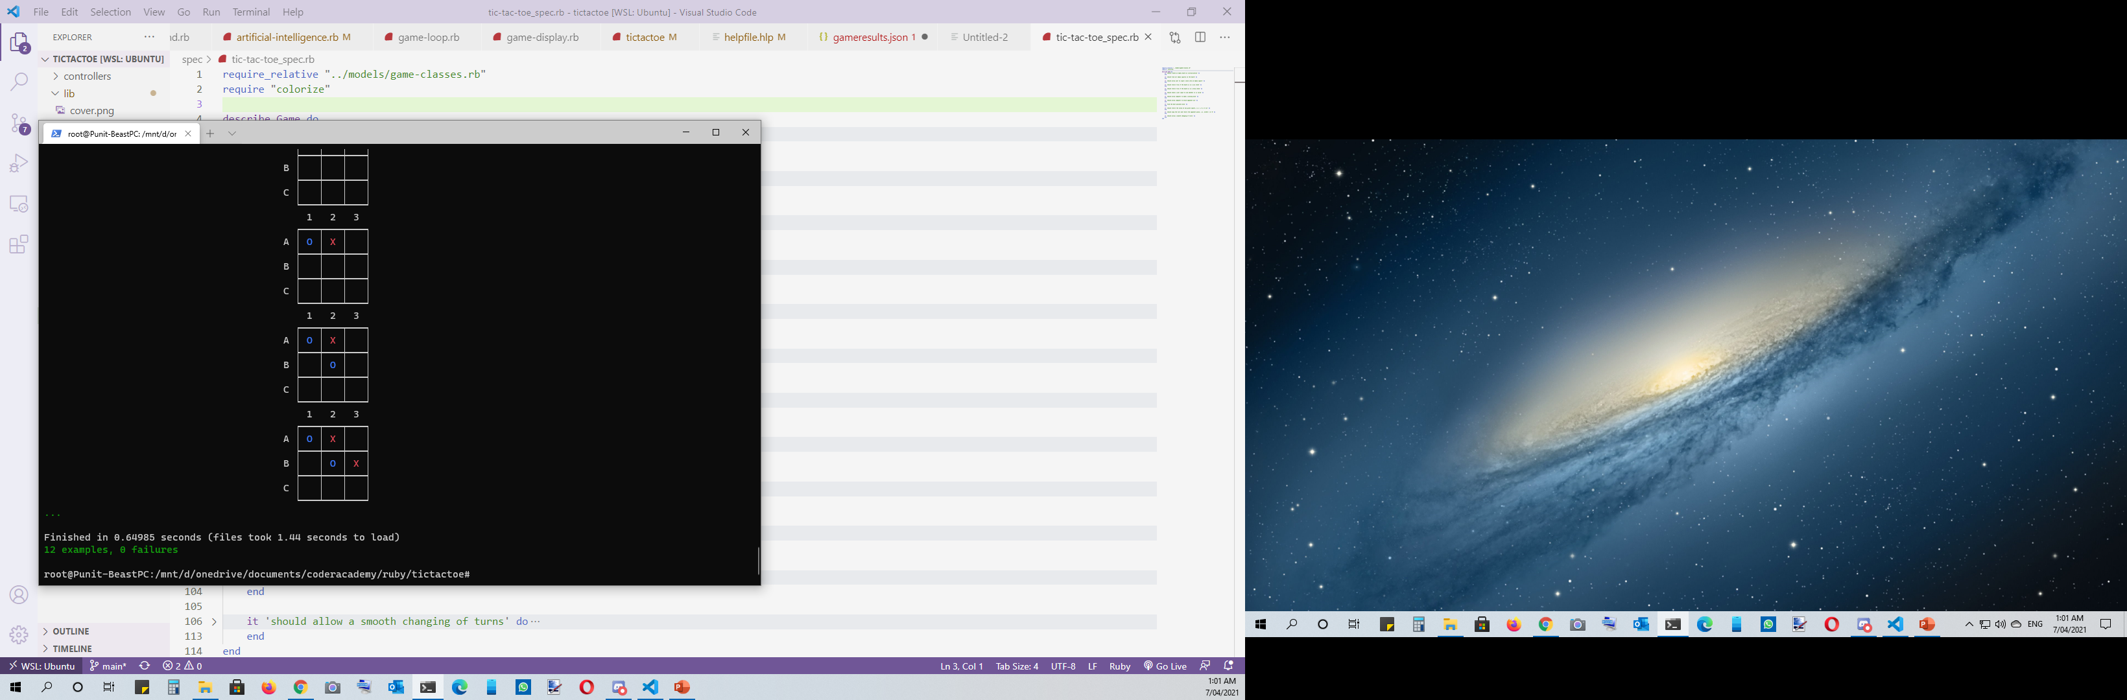
Testing (TDD) and `rspec`

Slide 26
TT-Why-Prompt? > Selected Not-Selected

Slide 27
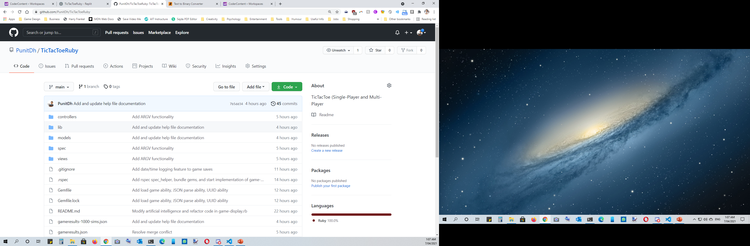
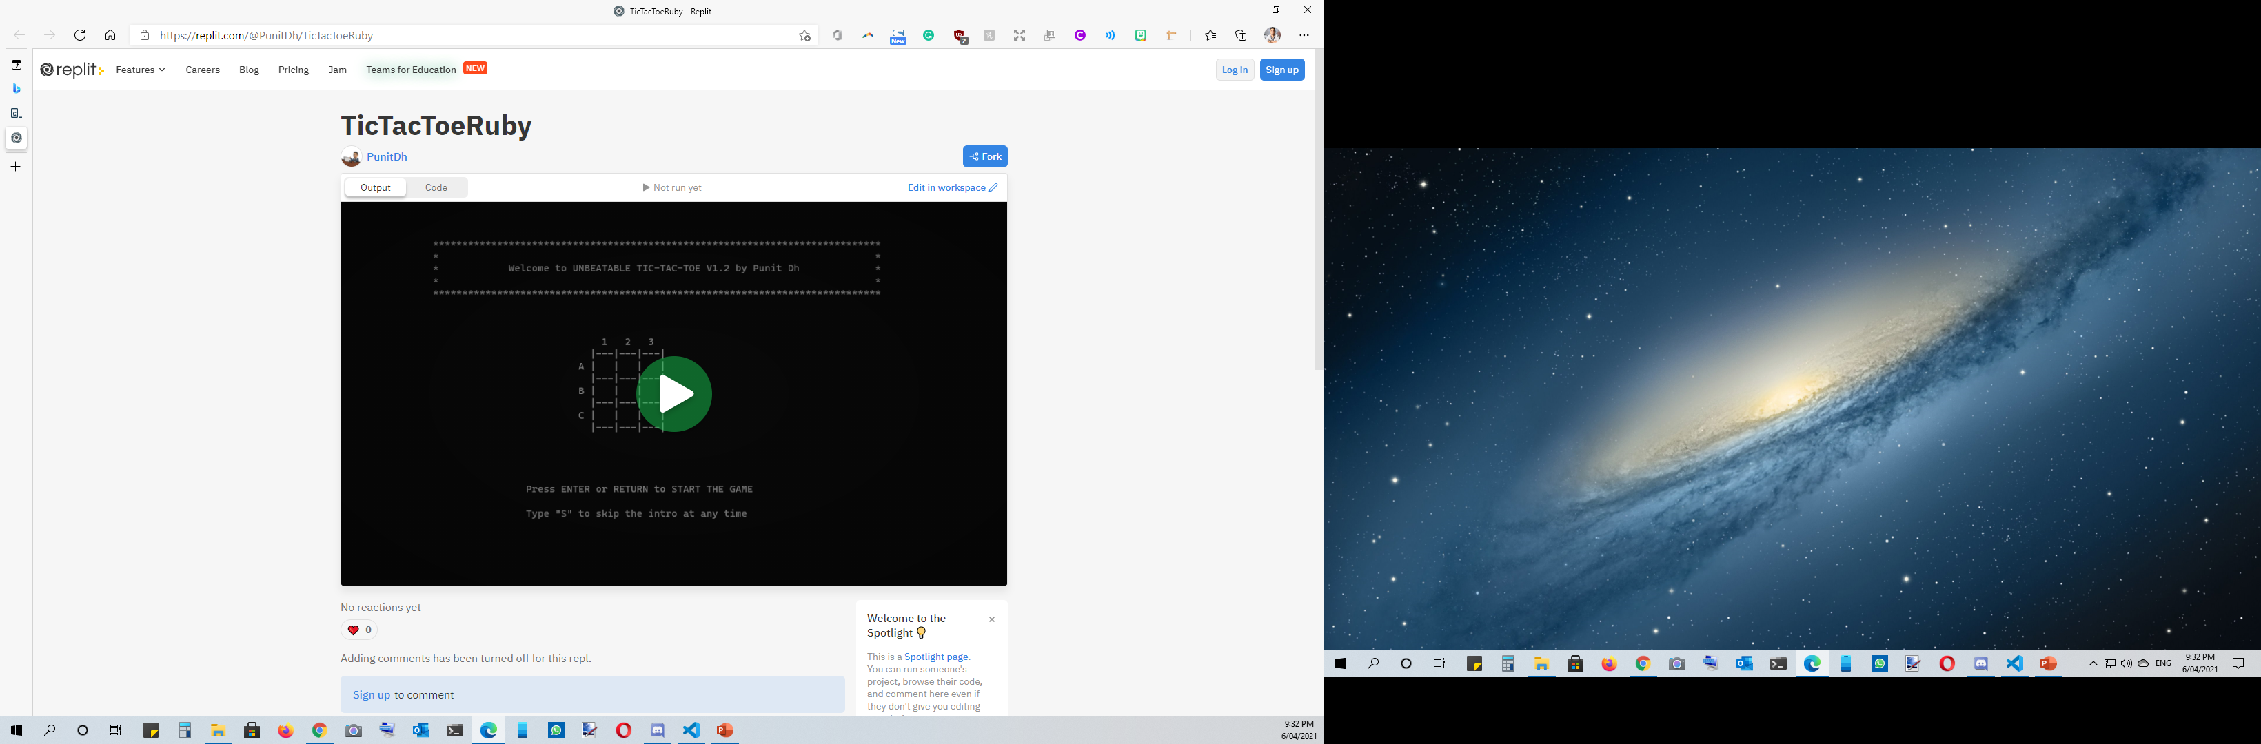
Repository
https://github.com/PunitDh/TicTacToeRuby
https://replit.com/@PunitDh/TicTacToeRuby

Slide 28
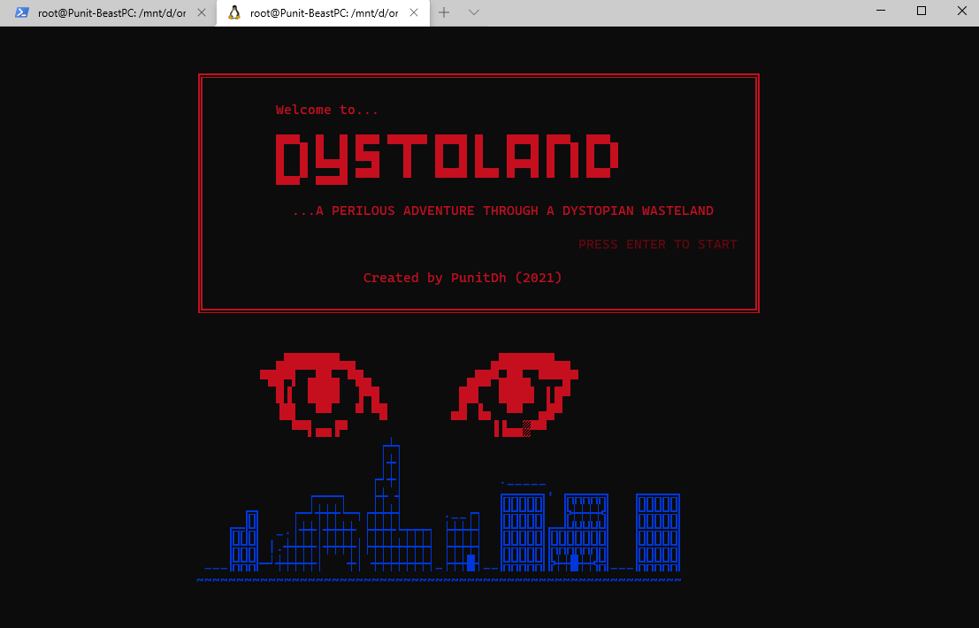

Future Projects…
Looking forward to more AI-based projects…
https://github.com/PunitDh/Dystoland

Slide 29
THANKS!
Do you have any questions?
punit04@gmail.com
https://punitdh.github.io
Please keep this slide for attribution.
Notes:
Good morning
Today I want to present my Terminal Application and what I’ve built so far.
Here’s a quick presentation agenda: I’ll quickly go over the features of the application (2min)
I’ll do a live demo of my application.
And then the rest of the presentation I’ll be spending discussing the Application logic, the code, and the design process
Okay.. so … some of you may know this already.. But I am buiding a TicTacToe Game that has an unbeatable AI.
Now I’ve been a hobby game developer for a long time.. And we were Tic Tac Toe in class the other day and it inspired me to do my own version of TicTacToe.. where not only can you play with another player but also play against the computer
And I wanted to create something where the computer actually responds intelligently and tries to win…
So here are the features of my application:
There’s a single player and 2-player mode
Simulation Mode which I’ll discuss a bit later on
Instruction manual
Ability to save games to a file
Load previous games from a file
And last but not least, Unbeatable AI
So there was my first problem…
Whenever you’re creating a turn-based game or anything, In computer science there is something called Game-Tree Complexity.
It basically refers to how many possible moves are there after an X number of turns.
For example in Chess, if you try to look 6 moves ahead, that’s about 120 million possible combinations… And the number of possible Chess games also known as Shannon number is something like 10¹²³ which is a number so large that it’s ridiculous
But TicTacToe has an advantage… it’s much smaller…
Now why is this relevant?
Do Live demo
Now I just wanna walk you through my code
It’s easier to show you in VS Code, but when you run tictactoe as an executable, the first thing it does is run command line arguments.
The game only runs if there are no command line arguments.
There are 3 classes and 1 module.
The one I wanna talk about is the computer response. To program the computer response, we have to go far back. To when I first started the project.
I was thinking how can I get the computer to spit out a value? How does the computer know which square to play?
So what I started with doing was just picking an empty square at random and just playing that. Just initially.
Here you can see a representation of the functions.
BTW, the rand() function I found that to be quite redundant because I found a much shorter and quicker way of doing exactly that and it’s by using Array sampling.
Here’s another function I wrote. This is what lets the computer predict whether the next move is going to be a win or a loss.
The way it does this is by taking in the board as an argument. Then it creates a duplicate of the board, then iterates through the board assigning a value to each square and checking if that leads a win.
Taking it beyond to Algorithms..
Okay… so.. so far my program was working quite okay… It was spitting out random values and was accurately predicting whether it was about to win or lose. But it still wasn’t good enough…
I wanted to create something that was unbeatable.
So I decided to look up algorithms…
I didn’t just want the computer to just spit out a random move… I wanted it to play intelligently…
So I used the Minimax algorithm…
What this basically does it creates a sort of tree… A tree of all possible moves and picks the move that will lead to a win…
So let me just demonstrate what that looks like here…
So lets say for example we have this board…3 X and 3 O
And it’s X’s turn to play
Now how does X know which square to pick?
So what this algorithm will do is find the empty squares on the board
Then it will iterate through each of them
X’s turn to play… Just checking to see what will happen… win or draw
O’s turn to play… same deal..

